Slide 1

Introduction to Git and GitHub
By: Muhammad Elsadany
Notes:
Good morning/afternoon everyone,
I hope you're all doing well today. I'm really excited to be here with you all to talk about something that's not only incredibly important in the world of research computing but also has the potential to revolutionize the way we collaborate on projects.
To set the stage, let's take a little journey together. Imagine for a moment that we're all artists. Each of us has our own canvas, and while we're individually talented, we've been given a challenge: to create a masterpiece together.
Now, how might we go about this? How can we ensure that our artistic visions align, that our strokes complement each other, and that we're able to combine our talents seamlessly? That's where our collaborative art studio comes in - and in the world of technology, this studio is known as GitHub.
In this studio, we'll have tools that allow us to work on our own pieces (our local machines), make changes, and even experiment with new techniques (thanks to Git). We'll have a gallery, where we'll display our work, discuss ideas, and improve upon each other's contributions.
We'll have a bulletin board, too, for those moments when we have brilliant flashes of insight or notice areas that could use a little extra attention. And for the organizers among us, we'll have an exhibition space to help us see the bigger picture and understand how all our pieces fit together.
But what truly makes this studio special is the collaborative spirit. Every idea, every brushstroke, every stroke of the keyboard, contributes to our shared masterpiece. We all have a stake in this creation, and together, we can achieve something truly remarkable.
So, today, we're going to dive deep into this collaborative art studio called GitHub. We'll explore its tools, understand how it empowers us to work together seamlessly, and how it can enhance the way we approach research computing.
Are you all ready to embark on this creative journey with me?
Let's dive in!

Slide 2
Outline
Understanding Version Control
Navigating Git
Benefits of GitHub in Research
Q&A

Slide 3
Version Control System (VCS)
﻿A way to manage files and directories
﻿﻿Track changes over time
﻿﻿Recall previous versions
Notes:
Definition of Version Control:
"Imagine you're working on a group project. How do you keep track of changes and ensure everyone is on the same page?"
Importance in Research Computing:
"Version control does just that. It's like a time machine for your project."
What is it
A method for centrally storing files
Keeping a record of changes
Who did what, when in the system - Covering yourself when things inevitably go wrong

Slide 4


What is Git?
Definition:
A distributed version control system that allows multiple people to work on the same project at the same time.
Basic explanation of how Git works
Each user has a local copy of the entire project, including its history.
A command line version control program
Cross-platform (including Windows!)
Open source, free
Linus Torvalds
Notes:
Definition of Git:
"Git is like the magic behind version control. It allows multiple people to work on the same project at the same time, like a digital playground."
Basic explanation of how Git works:
"Each of you has your own sandbox (local copy), but you can still share toys (project files) with others."
﻿created by Linus Torvalds, April 200

Slide 5

Is Git for me?
People primarily working with source code
Anyone wanting to track edits (especially changes to text files)
review history of changes
anyone wanting to share, merge changes
Anyone not afraid of command line tools

Slide 6
Collaborative Art Studio VS. Git
Canvas | Repository (Repo)
Tools | Git
Easel | Local Machine
Gallery | Github
Collaboration | Pull Requests
Versioning | Commits and Branches
Notes:
Imagine you and your friends are artists. Each of you has a canvas to work on, but you want to create a masterpiece together. This is where the collaborative art studio, GitHub, comes in.
Canvas (Repository): Your canvas is your project. It could be a painting, a sculpture, or even a multimedia installation - in the world of code, it's your software project.
"repo" = repository
usually used to organize a single project repos can contain folders and files, images, videos, spreadsheets, and data sets - anything
your project needs
Tools (Git): Git is like your magical paintbrush. It allows you to make changes, add details, and even undo if something doesn't turn out as expected.
Easel (Local Machine): Each artist (developer) has their own easel (local machine). This is where you work on your part of the project.
Gallery (GitHub): GitHub is the gallery where all the canvases are displayed. It's where you and your friends showcase your work, discuss ideas, and make improvements together.
Collaboration (Pull Requests): Let's say you want to add a beautiful sunset to the background of the painting. You create a sketch, take a picture, and share it with your friends. They can look at it, suggest changes, and discuss until everyone agrees it's perfect. This is like creating a pull request on GitHub.
Versioning (Commits and Branches): If someone wants to try a different technique, they can create a copy of the canvas, make changes, and compare. This is similar to creating branches in Git. And when you're happy with a particular version, you save it as a milestone - this is like making a commit.

Slide 7
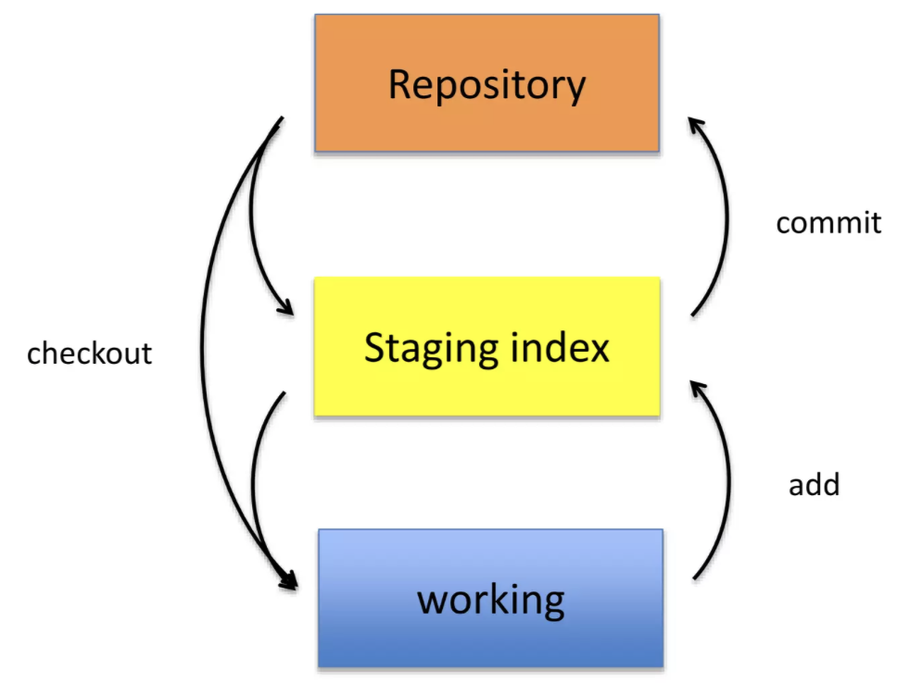
Git uses a three-tree architecture
Working Directory:
The actual files on your local system.
Where you make changes and edits to your project.
Staging Area (Index):
Acts as a middle ground between your Working Directory and the Repository.
Files here are ready to be committed.
Repository (Commit History):
Contains all the committed versions of your project.
Each commit represents a snapshot of the project at a specific point in time.
Notes:
Commits:
A commit is a snapshot of your project at a specific point in time.
"Commits are like snapshots of your project. Think of them as milestones on your journey."
Branches:
Branches allow you to work on different parts of the project simultaneously.
"Branches are like different storylines in a choose-your-own-adventure book. You can explore new ideas without messing up the main story."
Merging:
Merging combines changes from different branches into a single branch.
"Merging is like weaving those storylines back together when you're ready to continue with one main narrative."
Pull Requests:
Pull requests are proposed changes that can be reviewed before merging.
"Pull requests are like invitations to a group discussion. They allow team members to review and discuss proposed changes."

Slide 8
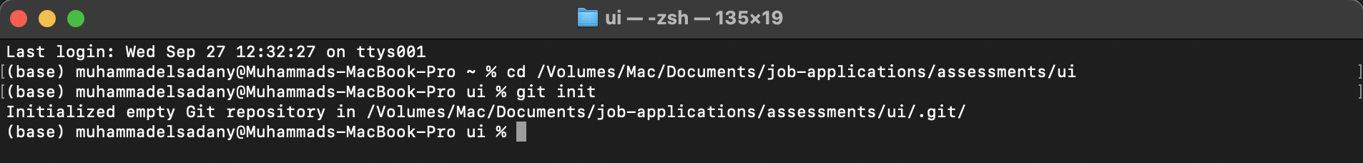
A Simple Git Workflow
Initialize a new project in a directory
git init
Add a file using a text editor to the directory
Add every change that has been made to the directory
git add .
Commit the change to the repo
git commit -m "important message here"

Slide 9
A Simple Git Workflow
Initialize a new project in a directory
git init
Add a file using a text editor to the directory
Add every change that has been made to the directory:
git add .
Commit the change to the repo:
git commit -m "important message here"

Slide 10
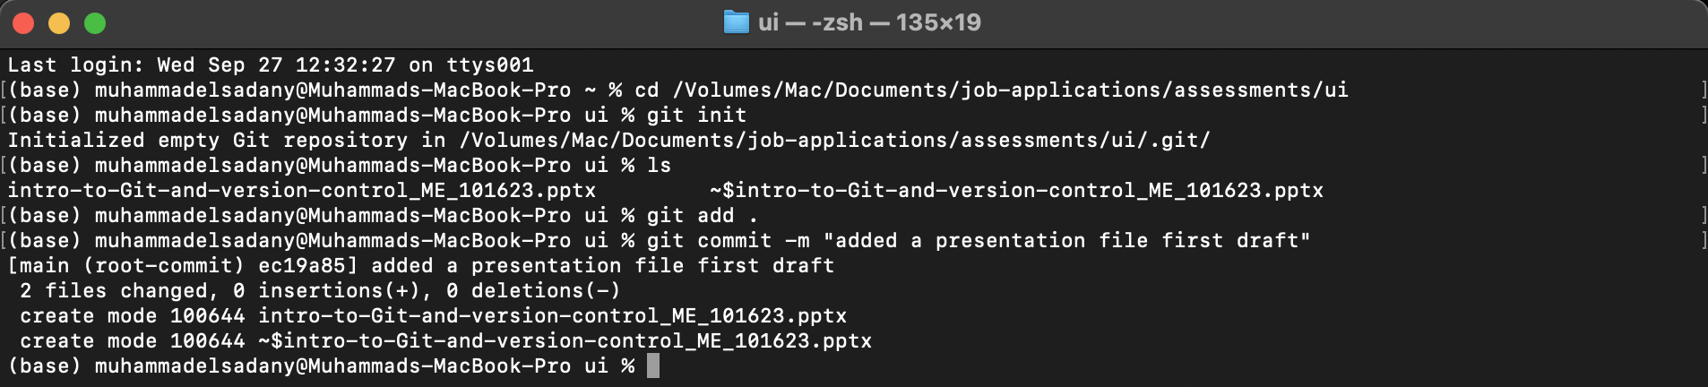
A Simple Git Workflow
Initialize a new project in a directory
git init
Add a file using a text editor to the directory
Add every change that has been made to the directory
git add .
Commit the change to the repo:
git commit -m "important message here"

Slide 11
A Simple Git Workflow
Initialize a new project in a directory
git init
Add a file using a text editor to the directory
Add every change that has been made to the directory
git add .
Commit the change to the repo
git commit -m "important message here"

Slide 12
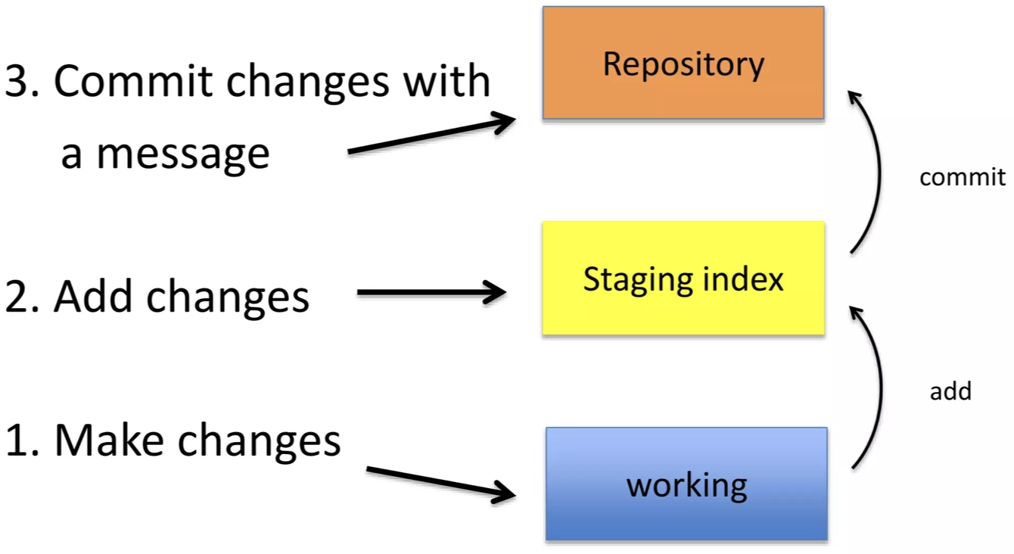
After Initializing a Git Repo..

Slide 13

A note about commit messages
Tell what it does (present tense)
Single line summary followed by blank space followed by more complete description
Keep lines to <= 72 characters

Slide 14
Good and bad examples
Bad:
"Typo fix"
Good:
"Add missing / in CSS section"
Bad:
"Updates the table. We'll discuss next

Slide 15
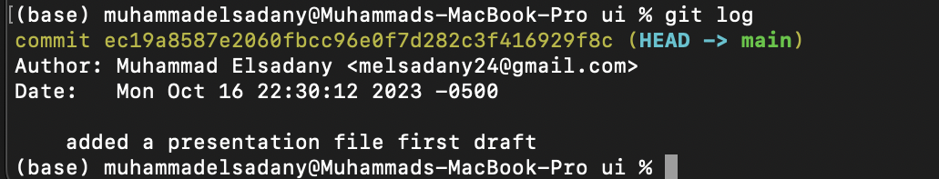
How to I see what was done?
git log

Slide 16
How to I see what was done?
git log

Slide 17
How to I see what was done?
git log

Slide 18
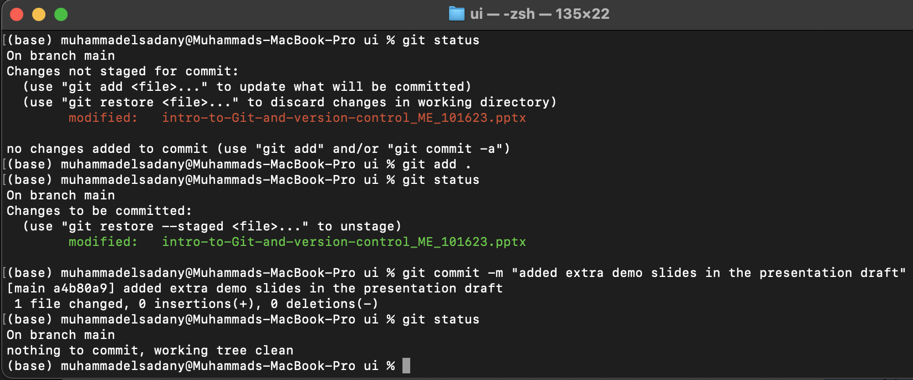
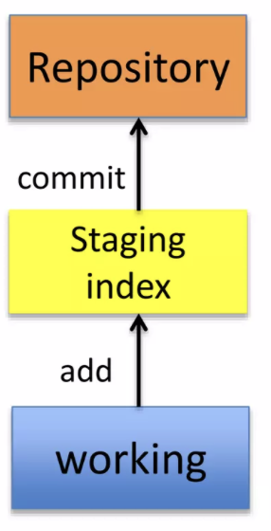
Which files were changed and where do they sit in the three tree?
git status
Allows one to see where files are in the three-tree scheme

Slide 19
Which files were changed and where do they sit in the three tree?
git status
Allows one to see where files are in the three-tree scheme

Slide 20
Which files were changed and where do they sit in the three tree?
git status
Allows one to see where files are in the three-tree scheme

Slide 21
Other Git Commands
To remove a file
git rm filename.txt
﻿moves deleted file change to staging area
﻿﻿It is not enough to delete the file in your working directory. You must commit the change
To move (rename) a file
git mv filename1.txt filename2.txt

Slide 22

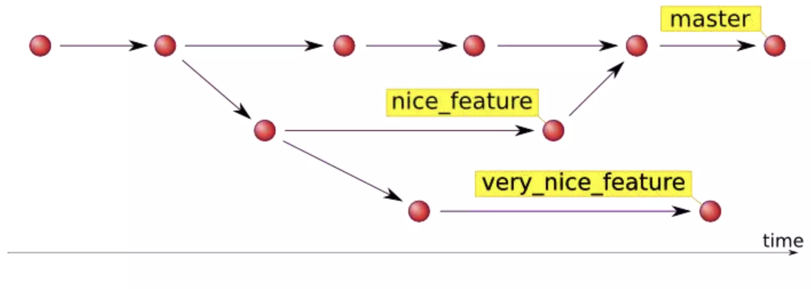
Branching
﻿allows one to try new idea
﻿If an idea doesn't work, throw away the branch. Don't have to undo many changes to master/main branch
﻿﻿If it does work, merge ideas into master branch
Source: http://hades.github.io/2010/01/git-your-friend-not-foe-vol-2-branches/

Slide 23

Good News!
75% of the time you'll be using only these commands:
git init
git status
git log
git add
git commit
git rm
git mv

Slide 24
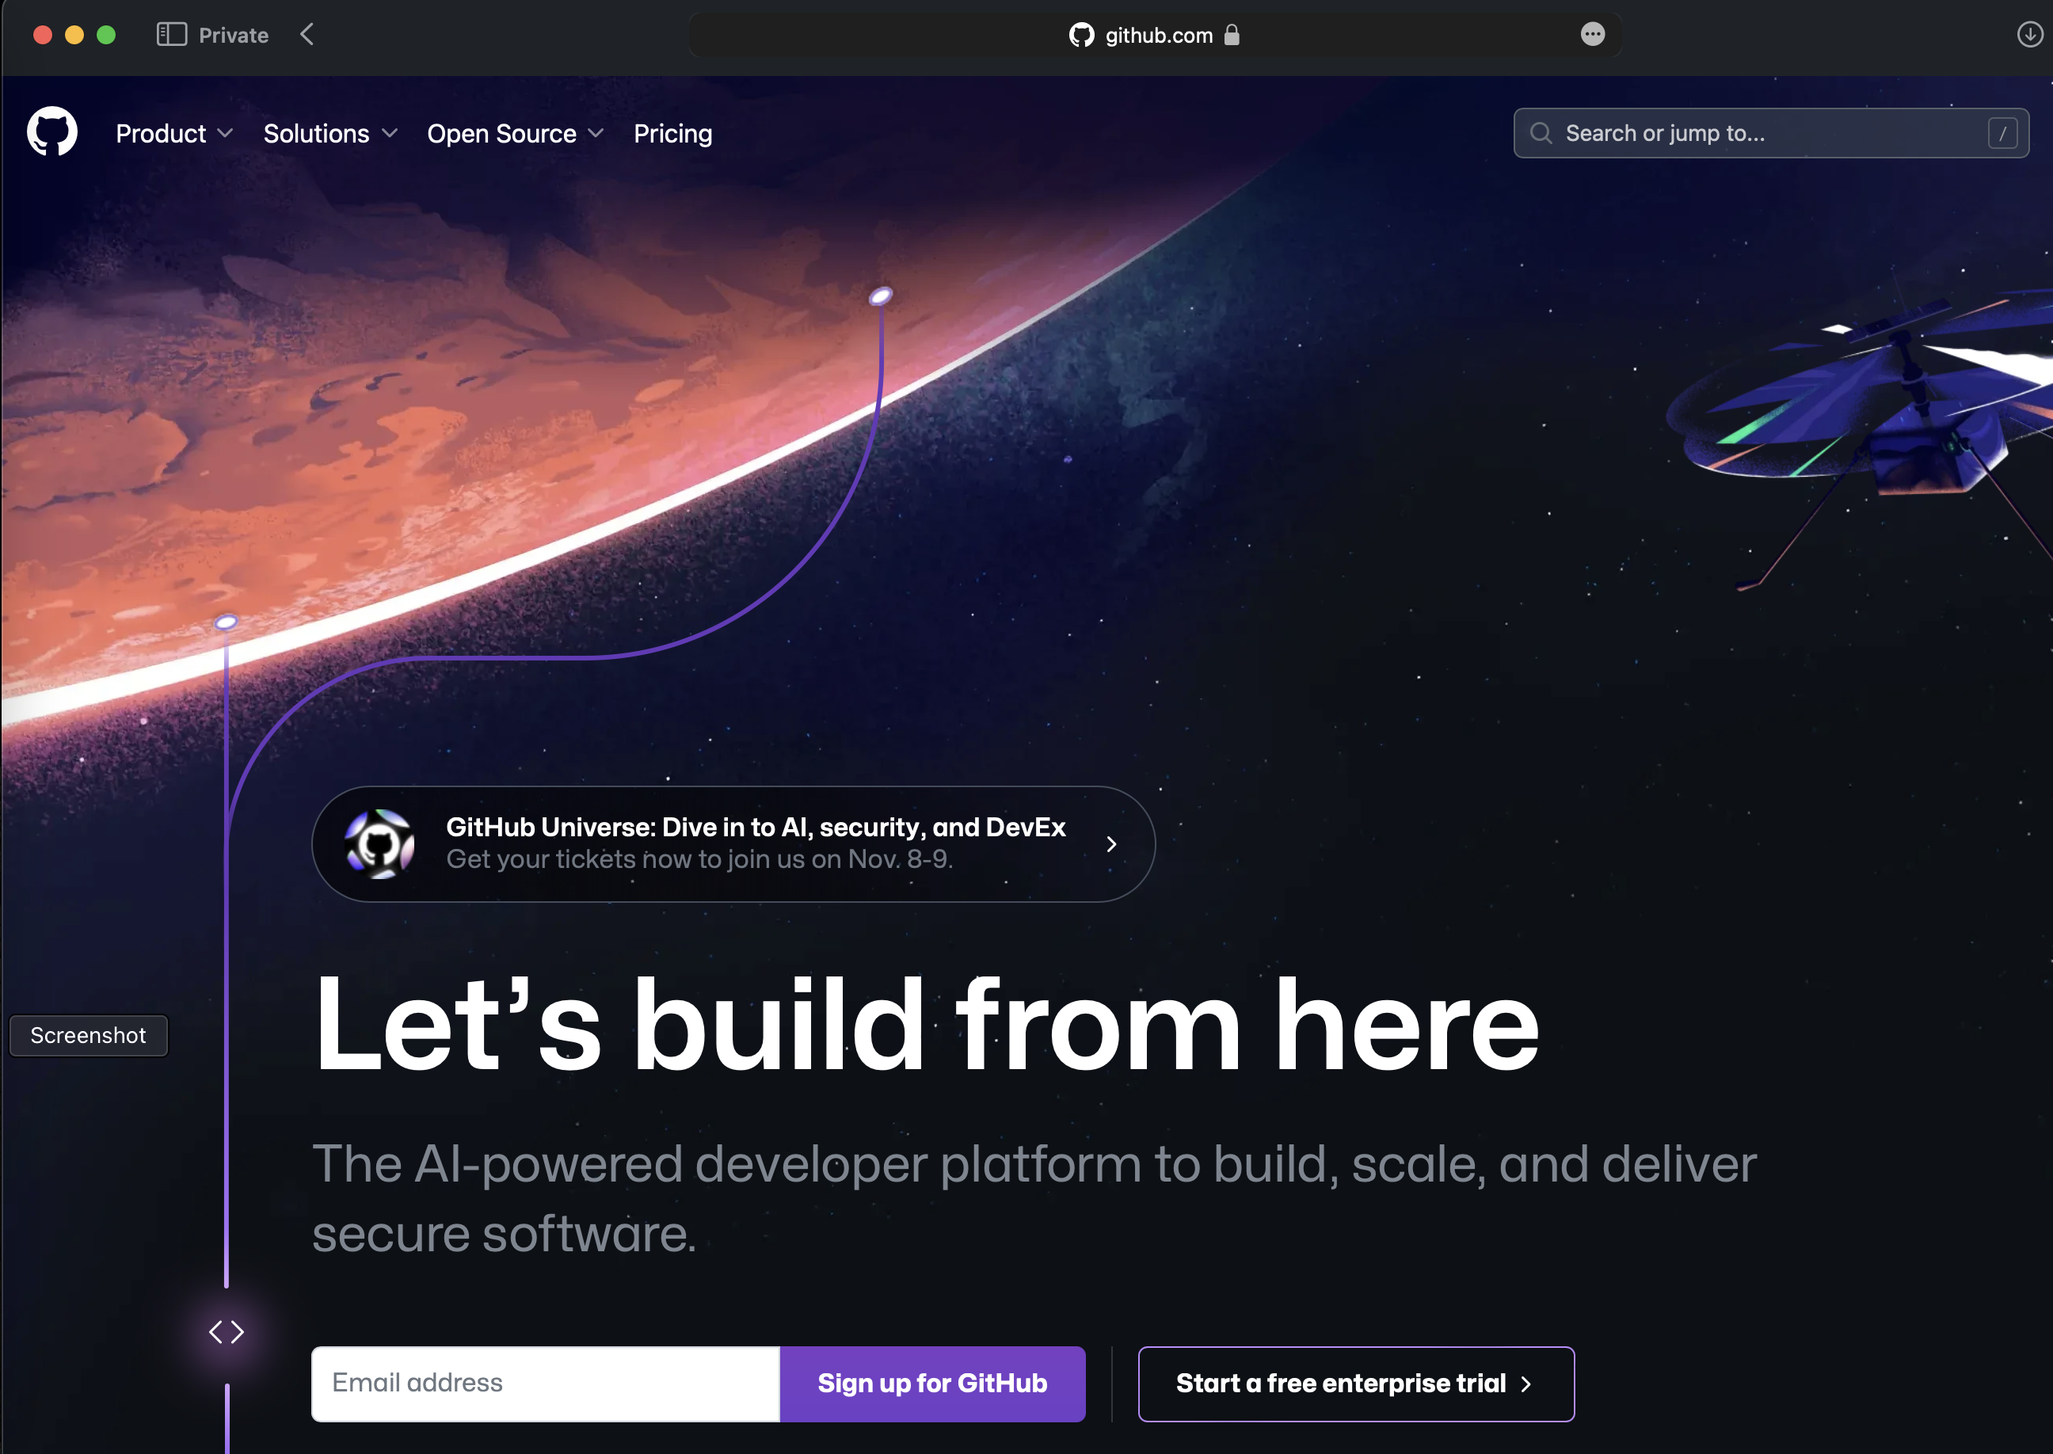
What is GitHub
﻿a platform to host git code repositories
﻿﻿http://github.com
﻿﻿launched in 2008
﻿﻿most popular Git host
﻿﻿allows users to collaborate on projects from anywhere
﻿﻿GitHub makes git social!
﻿﻿Free to start!
Notes:
Definition of GitHub
GitHub is a web-based platform that provides hosting for Git repositories and a range of collaboration features.
How GitHub enhances Git
Offers a user-friendly interface for managing repositories.
Facilitates easy collaboration among team members.
Definition of GitHub:
"GitHub is like a central meeting place for your project. It provides a space for storing and collaborating on your work."
How GitHub enhances Git:
"It's like adding a cozy lounge area to your playground. It makes collaboration more comfortable and organized."

Slide 25
How do I link my local repo to a remote repo?
Which remotes am I linked to?
git remote
git remote add <alias> <URL>
This just establishes a connection...no files are copied/moved
Yes! You may have more than one remote linked to your local directory!

Slide 26
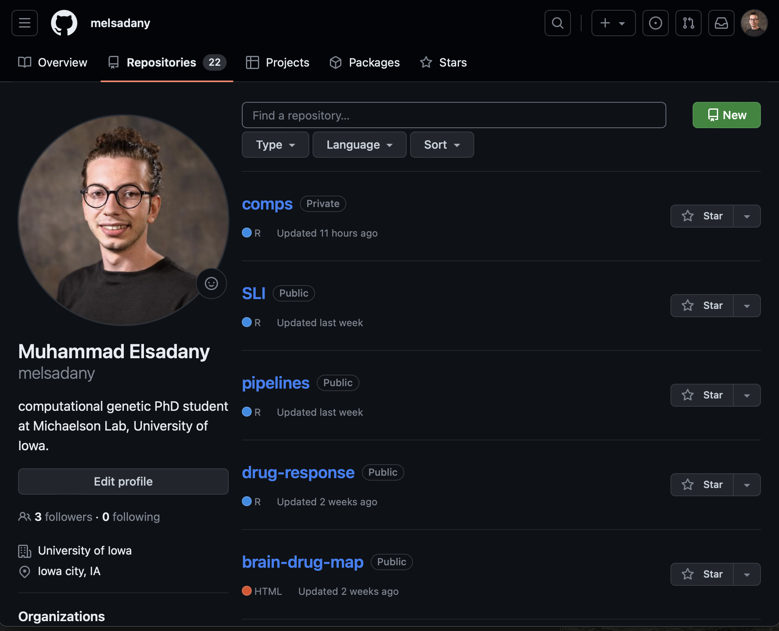

Slide 27
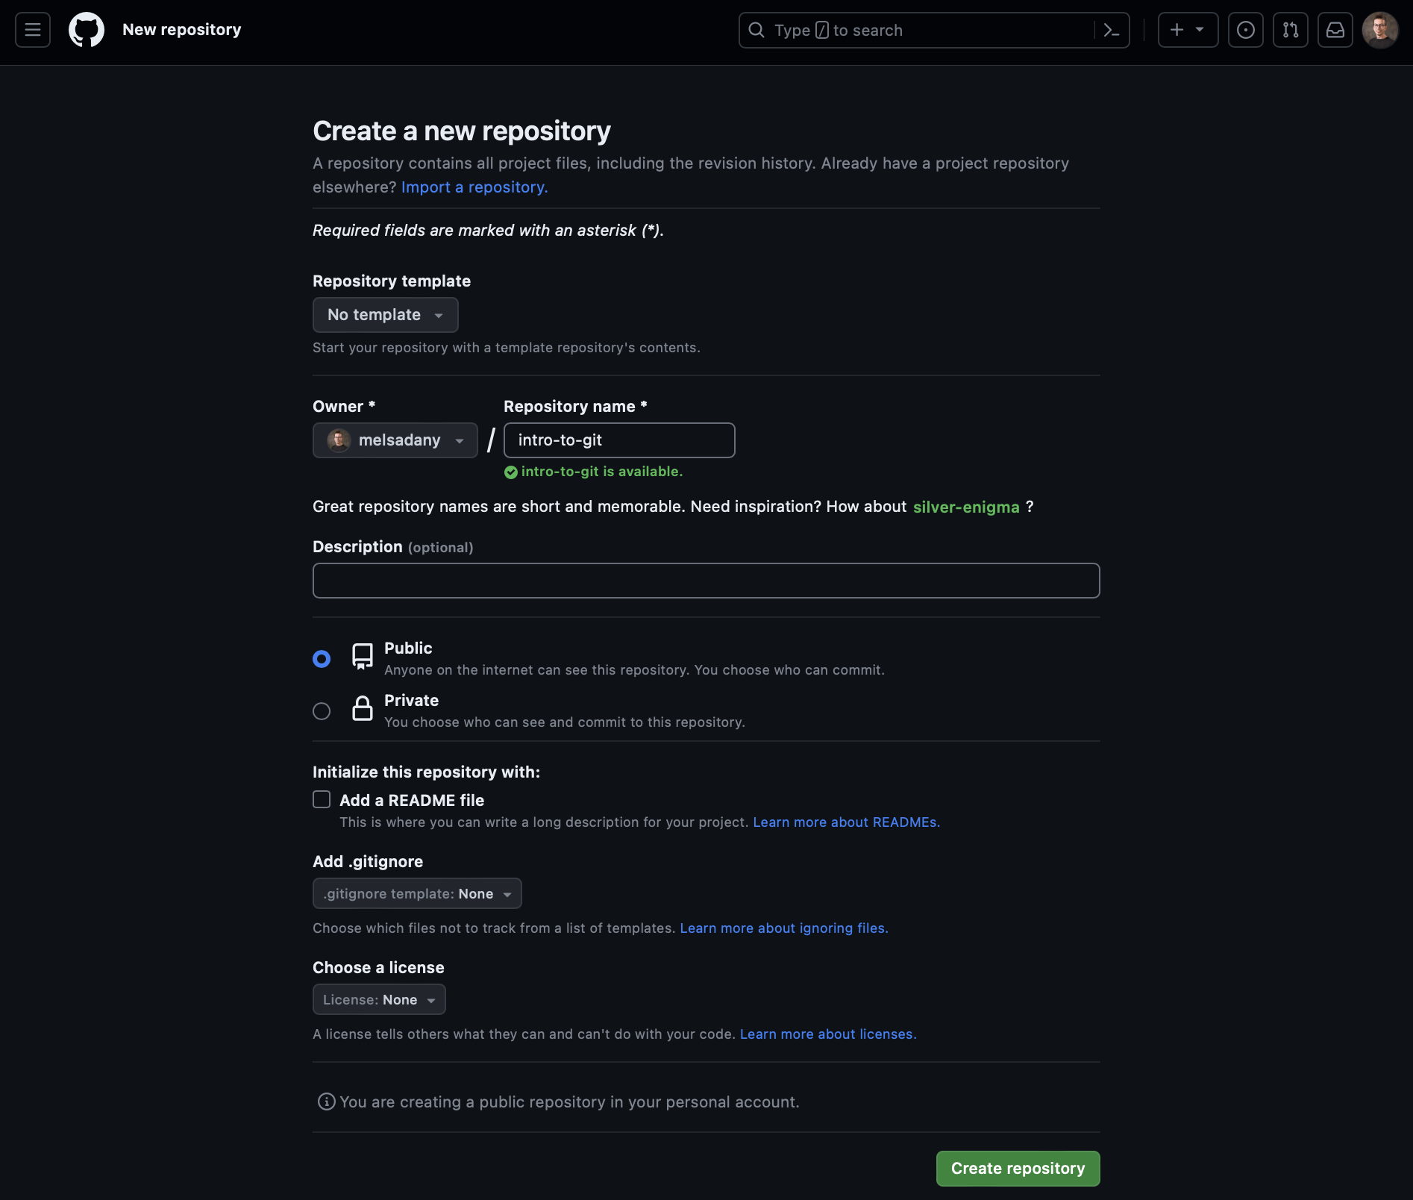

Slide 28
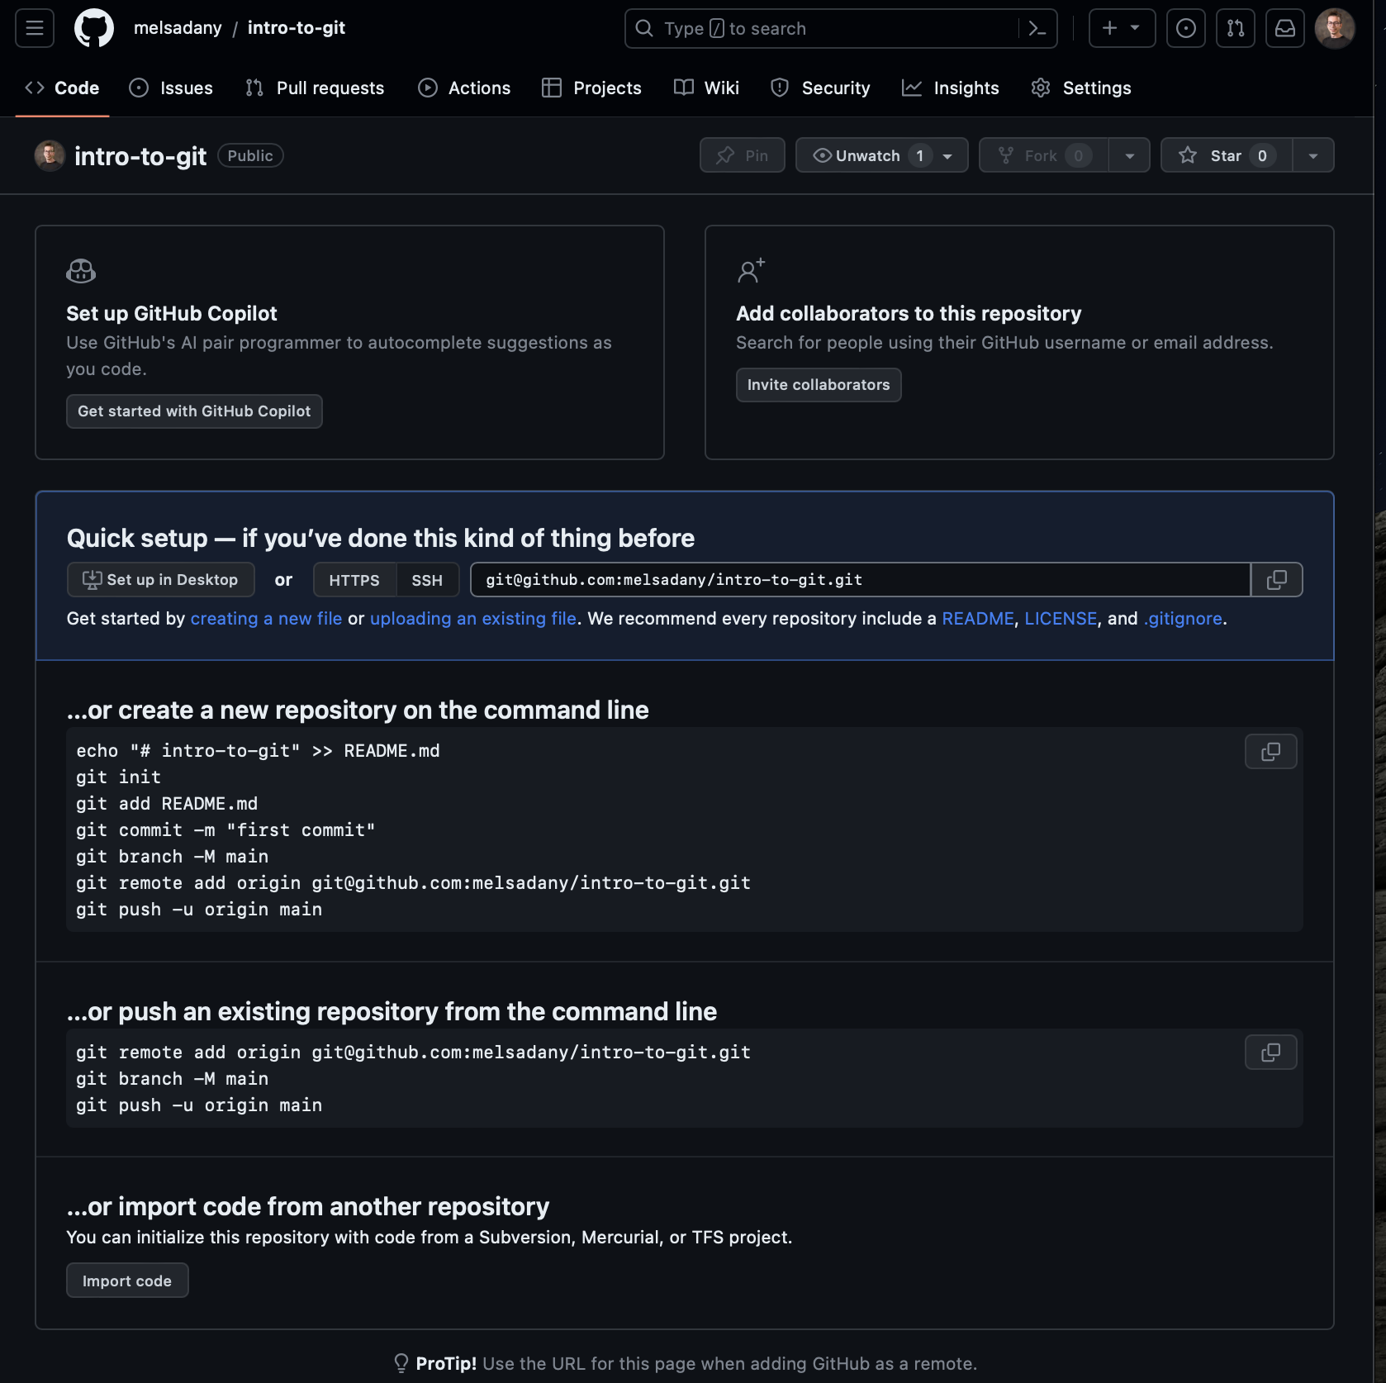

Slide 29
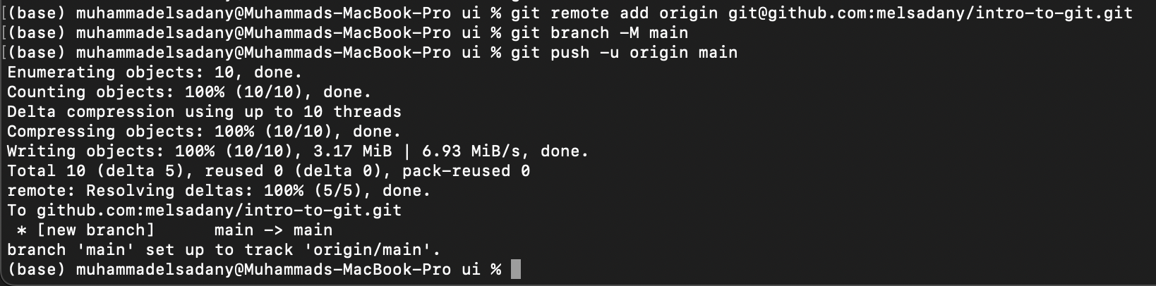

Slide 31
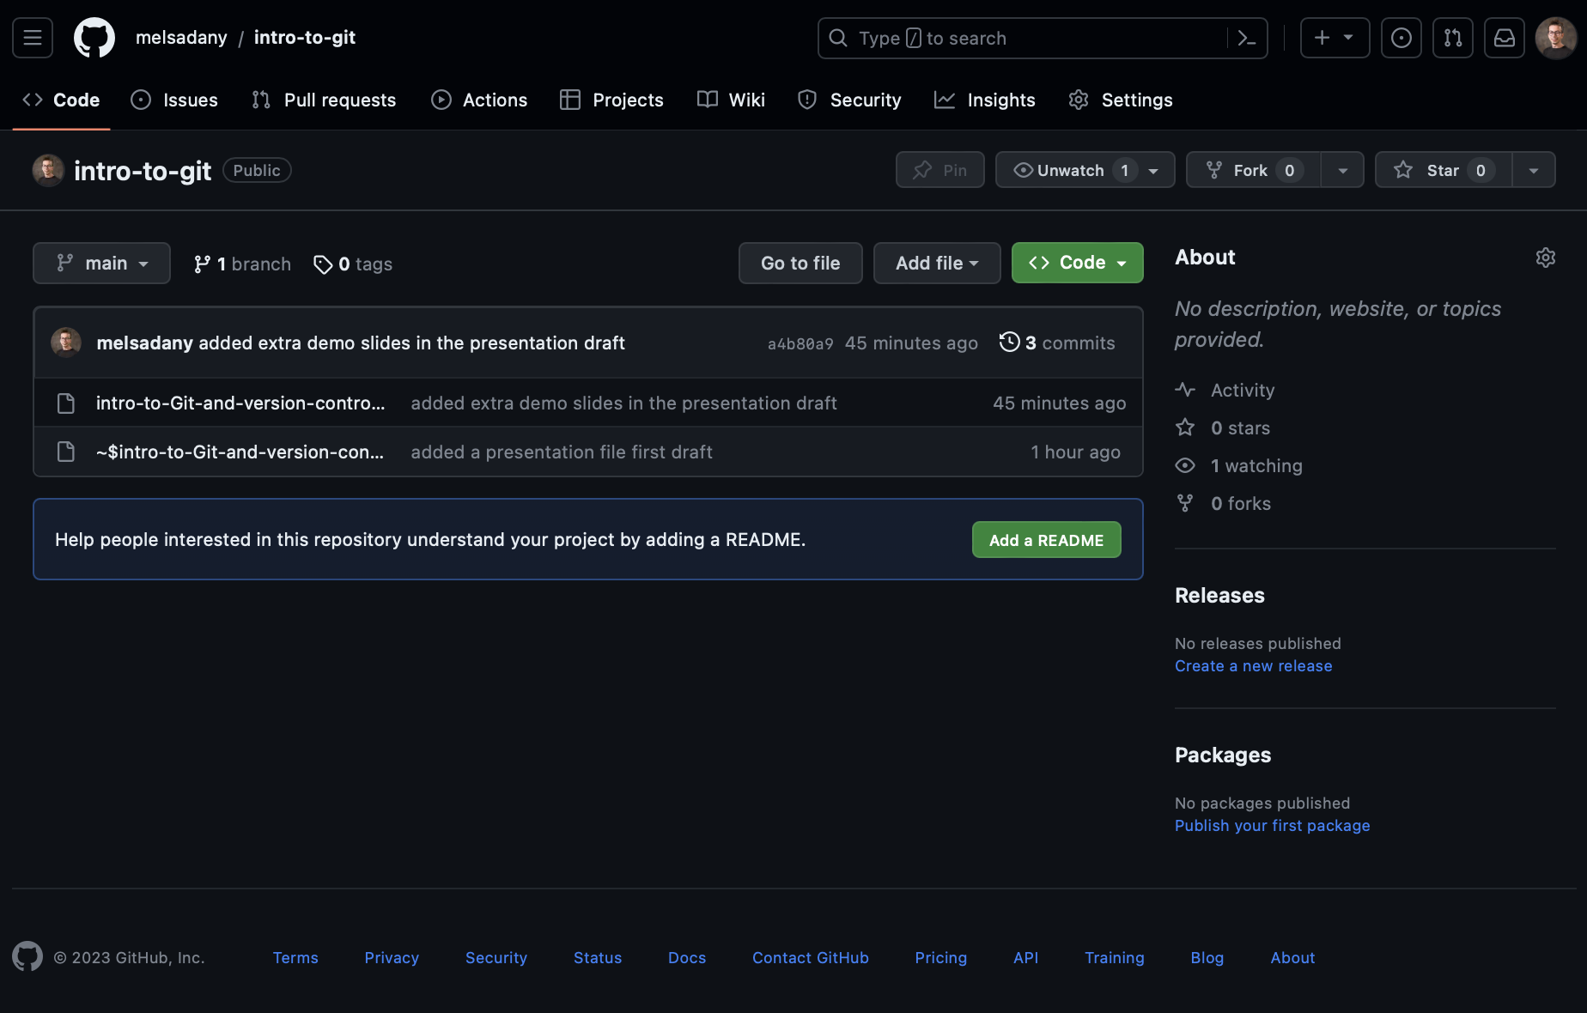
Notes:
Things I didn’t cover:
How to pull
How to add different collaborators
How to manage conflicts in versions
How to set-up Git on your computer and make it work with github

Slide 32
Good Sources
Git from Git:
https://git-scm.com/book/en/v2
https://docs.github.com/en
A guided tour that walks through the fundamentals of Git:
https://githowto.com
Linus Torvalds on Git:
https://www.youtube.com/watch?v=idLyobOht04
Git tutorial from Atlassian:
https://www.atlassian.com/git/tutorials/
A number of easy-to-understand guides by the GitHub folks
https://guides.github.com

Slide 33
Benefits of Using Version Control and GitHub in Research Computing
Improved Collaboration
Reproducibility
Versioning and History

Slide 34
Best Practices in Version Control and GitHub
Clear commit messages
Using branches effectively
Collaborative workflows

Slide 35
References and Tutorials
https://git-scm.com/book/en/v2
https://github.com/skills/introduction-to-github
https://docs.github.com/en
https://docs.github.com/en/authentication/connecting-to-github-with-ssh/generating-a-new-ssh-key-and-adding-it-to-the-ssh-agent

Slide 36

Q&A

